Slide 1
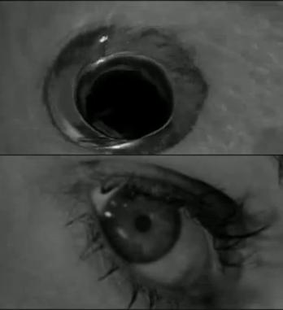
Graphic Matching
English 40163
Dr. Curt Rode

Slide 2
Form = Content
Quick Review | “Form = Content” means:
The way a word is materially delivered becomes part of the word’s connotative meaning. The material delivery also factors into logos, pathos, and ethos.
Additionally,
If you change a material characteristic of a verbal composition, you alter part of the connotative meaning of that composition.

Slide 3
TCU ENGLISH OUTLINED-02.png

Slide 4
TCU ENGLISH OUTLINED-02.png
To establish narrative connection between images
To establish associative or conceptual connection between images

Slide 5
TCU ENGLISH OUTLINED-02.png

Slide 6
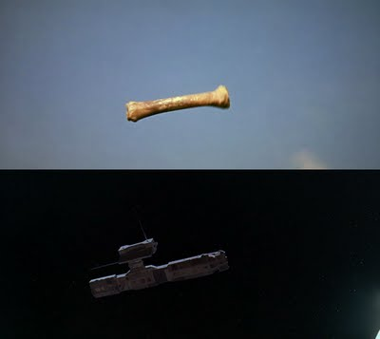
TCU ENGLISH OUTLINED-02.png

Slide 7
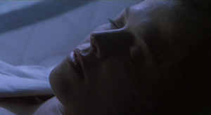
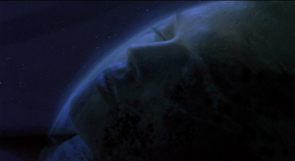
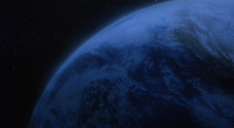
TCU ENGLISH OUTLINED-02.png

Slide 8
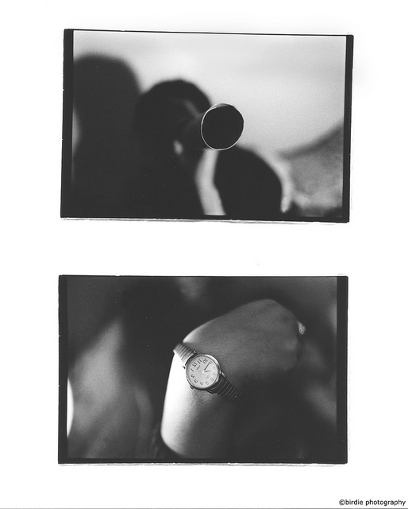
TCU ENGLISH OUTLINED-02.png

Slide 9
Exercise
Take a minimum of 4 photographs today during class time.
Compose each image so that it graphically matches at least one of the other images you create today.
How image A graphically matches image B may be different than how image B graphically matches image C. In other words, you don’t have to match the same shape or detail in all 4 images, but each image should be graphically matched to the one either preceding or following it.
Crop each image in Photoshop (as needed) so that the graphically matched details are roughly in the same location in both images.
Sequence the images in PowerPoint.
Upload sequence into Doc Sharing and make it available to whole class.
TCU ENGLISH OUTLINED-02.png

